Slide 1


Fire Operational Study
Town of
Southwest Ranches, FL
Strengthening Exceptional
Fire & EMS Services
Notes:
6

Slide 2

CORPORATION
(History)

Slide 3

Nationwide Experience
25 Years of
Experience in More Than
140 Counties & Cities

Slide 4
Fire/EMS Department Studies/Plans
50 of 140+
Little Falls
St. Paul
Plymouth
Allentown
Downingtown
Lower Merion
Norristown
Upper Merion
York Area
North Tonawanda
Springfield, MA
St. Louis Park
Larchmont
Tacoma
Greenwich
Hartford
Chicago
Cranston
Fremont
Stamford
Greenwich
Kalamazoo
Cherry Hill
Hudson County
Lincoln Park
Maplewood
Millburn
North Bergen
South Orange
Vineland
Wall
West Windsor
Coffey County
Grandview
St. Mary’s County
Washington Cnty.
Calvert County
Los Angeles
Port Arthur
Chesterfield
Hampton
Isle of Wight Co.
Stafford Co.
El Mirage
Chandler
Queen Creek
Lancaster
Port Arthur
Parkland
Sunny Isles Beach

Slide 5
Fire/EMS Agencies Evaluated
Alert Fire Company (PA)
Amogerone Fire Company (CT)
Aquia Habour Rescue Squad (VA)
Banksville Fire Company (CT)
Bay District FD (MD)
Belltown Fire Department (CT)
Boonsboro Ambulance Co. (MD)
Boonsboro Fire Department (MD)
Briarcliff Manor Fire Department (NY)
Brooke Rescue Squad (VA)
Brooke Fire Department (VA)
Brooksville Engine & Hose Co. (NY)
Buckroe Rescue Squad (VA)
Buckroe Fire Company (VA)
Carrollton Vol. Fire Department (VA)
Carrsville Vol. Fire Department (VA)
Clearspring Vol. Ambulance Co. (MD)
Clearspring Vol. Fire Department (MD)
Coffey County Fire District #1 (KS)
Community Rescue Co. (MD)
Cos Cob Fire Company (CT)
Downingtown Fire Department (PA)
East Port Chester Fire Department (CT)
Fairmont Engine Company (PA)
Fairplay Vol. Fire Department (MD)
Falmouth Vol. Fire Department (VA)
Fox Hill Fire Company (VA)
Funkstown Vol. Fire Department (MD)
Glenbrook Fire Department (CT)
Glenville Fire Department (CT)
Guttenberg Fire Department (NJ)
Halfway Vol. Fire Department (MD)
Hampton Volunteer Fire Company (VA)
Hancock Vol. Ambulance Co. (MD)
Hancock Vol. Fire Department (MD)
Hancock Fire Engine Company (PA)
King of Prussia Fire Company (PA)
Lafayette Rescue Squad (PA)
Larchmont Fire Department (NY)*
Leitersburg Vol. Fire Department (MD)
Leonardtown Fire Department (MD)
Lincoln Park Fire Department (NJ)
Lincoln Park First Aid Squad (NJ)
Little Falls Vol. Fire Department (MN)
Long Ridge Fire Department (CT)
Longmeadow Vol. Fire Dept. (MD)
Maplewood Ambulance Squad (NJ)
Maugansville Vol. Fire Dept. (MD)
Mechanicsville Fire Department (MD)
Mellor Engine & Hose Co. (NY)
Millburn Ambulance Squad (NJ)
Minquas Fire Company (PA)
Minquas Ambulance Squad (PA)
Montgomery Fire Engine Co. (PA)
Mountain View Rescue Squad (VA)
Mt. Aetna Vol. Fire Department (MD)
Norristown Hose Company (PA)
Northampton Fire Company (VA)
North Tonawanda Fire Dept. (NY)*
Parkland City Fire Dept. (FL)*
Phoebus Fire Company (VA)
Phoebus Volunteer Rescue Squad (VA)
Princeton Junction Fire Company (NJ)
Port Chester Fire Department (NY)
Potomac Valley Vo. Fire Dept. (MD)
Purchase Fire Department (NY)
Putman Engine & Hose Co. (NY)
Ridge Fire Department (MD)
Harry Howard Hose & Ladder (NY)
Hartwood Vol. Fire Department (VA)
Hollywood Fire Department (MD)
Humane Fire Engine Company (PA)
Isle of Wight Rescue Squad (VA)
Rockhill Vol. Fire Department (VA)
Round Hill Fire Company (CT)
Rushmere Vol. Fire Department (VA)
Rye Brook Fire Department (NY)
Seabrook Vol. Fire Department (TX)
Second District Fire Dept. (MD)
Seventh District Fire Dept. (MD)
Sharpsburg Vol. Ambulance Co. (MD)
Sharpsburg Vol. Fire Department (MD)
Smithfield Fire Department (VA)
Smithsburg Vol. Ambulance Co. (MD)
Smithsburg Vol. Fire Department (MD)
Sound Beach Fire Department (CT)
Springdale Fire Company (CT)
Spring Garden Fire Company (PA)
Stafford Vol. Fire Department (VA)
Stafford County Rescue Squad (VA)
Stafford Co. Dept of Fire& Res Svc (VA)
Swedeburg Fire Company (PA)
Turn of River Fire Department (CT)
Wall Township Rescue Squad (NJ)
Washington Park Hose Co. (NY)
West Windsor Fire Company (NJ)
White Oak Vol. Fire Dept. (VA)
Widewater Vol. Fire Dept. (VA)
Williamsport Vol. Fire Department (MD)
Windsor Rescue Squad (VA)
Windsor Vol. Fire Department (VA)
Wythe Volunteer Fire Company (VA)

Slide 6


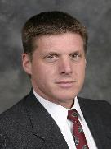

Town of
Southwest Ranches
Fire, EMS & Dispatch
Management
Consultants
Les Adams, President & CEO
Project Manager/Author for 120+ Public Safety Studies/Master
Plans/Reports on Police, Fire, EMS, Communications,
Emergency Preparedness
Consultant in more than 130 Municipalities over 22 Years
22 Years in Fire & EMS Service (Montgomery County, MD)
Deputy Chief of Operations
John Best
Fire Chief – Disney World FD
Fire/EMS Consultant – 22 Yrs.
Strategic Planning
County Fire Marshal
& Arson Chief
Bob McNally
Geo Info Systems
20 yrs. EMS provider
Consultant 110 counties & cities
Masters in GIS U of NC - Charlotte
Notes:
11

Slide 7
PHILOSOPHY
Provide Open & Honest Assessment
SAFETY FIRST: Customer & Provider
Offer Objective Approach
Place Priority on Human Element
Give Attention to
Specific Agency Mission
Consider Laws & Established
Standards (OSHA, NFPA, State)
Value Customer Input
Remain Mindful of Customer Service
Seek Out Member Ideas
Build on Strengths
Relate to Management’s Concerns & Goals
Offer Constructive Recommendations
COMMITTED TO EXCELLENCE IN PUBLIC SAFETY
COMMITTED TO EXCELLENCE IN PUBLIC SAFETY

Slide 8

SCOPE OF WORK

Slide 9
Primary Project Areas – Models to Assess
A Stand-alone FD, Eliminating Outside Contractor Reliance
Maintaining Contractual Fire and EMS Services
Maintaining Existing Outside Contractual Service w/ VFD
Identifying Other Viable Models, or Model Combinations
Notes:
14

Slide 10
SOUTHWEST RANCHES
PROJECT
METHODOLOGY

Slide 11
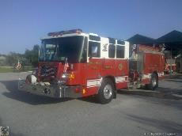
Organization Structures
Management Structure
Rank Structure
Planning for Fire Protection
Personnel Data
Staffing and Workload
Capital Improvement Needs
Suppression/Rescue/EMS Delivery
Location & Number of Fire Stations
Apparatus and Equipment
Training Program
Apparatus & Buildings Maintenance
Admin & Performance Guidelines
Communications & Dispatch
Record Keeping
Fire & EMS Policies Structure
A
P
P
R
O
A
C
H
Data
Collection
Weeks:
1
5

Slide 12
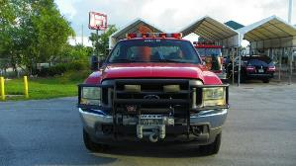
Chiefs
Captains
Town Staff
Elected officials
Appropriate Stakeholders
Service Provision Staff
Fire Alarm Staff
Fire & EMS Training
Admin Staff
A
P
P
R
O
A
C
H
Interviews
Weeks:
2
11

Slide 13
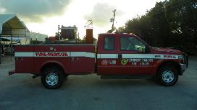
A
P
P
R
O
A
C
H
On-Site
Observations &
Fact Finding
On-Site Reviews
Visit All Facilities
Observe Service Delivery
Work Nights and Weekends
Attend Meetings @ Fire
Stations
Weeks:
2
12

Slide 14
A
P
P
R
O
A
C
H
Risk Analysis
Determine Geographic Decision Areas
Interview Data
Response Times
Staffing
Facilities
Apparatus
Equipment
Identify Resource Baselines
Analysis of
Data
Weeks:
7
16
Fire Stations
Apparatus
Specialty Units
Staff Deployment Approach
Fire & EMS Workload by Response Area
Onsite Inspection of Fire Stations & Resources

Slide 15
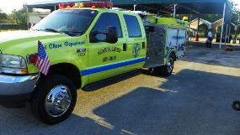
A
P
P
R
O
A
C
H
Comparative
Analysis
Weeks:
Benchmarking with State-of-the-Art Programs, Practices & Stds.
Recognize Existing Strengths
National Standards and Accepted Principles & Practices (e.g. NFPA 1710)
Insurance Services Office (ISO)
9
17

Slide 16
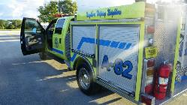
Individual Service Areas
Facility Condition and Locations
Apparatus Condition & Use
Resource Requirements
Optimal and Minimal Resource Deployment Models
Protection/Suppression
Demands Per Service/Company
Funding & Expenditures
Organizational Structure
Potential for Improvements
Anticipated Fiscal Impacts
Returns on Investments
A
P
P
R
O
A
C
H
Alternatives &
Recommendations
Weeks:
12
16

Slide 17

A
P
P
R
O
A
C
H
Comprehensive
Written Report
Weeks:
Analysis
Findings
Options
Recommendations
Timelines
Color Illustrations
14
18

Slide 18
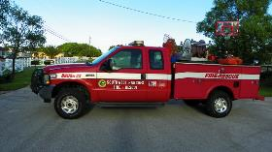
A
P
P
R
O
A
C
H
Report & Oral
Briefing
Submission of Written Report
In-depth Briefing
Including PowerPoint Presentation
22

Slide 19
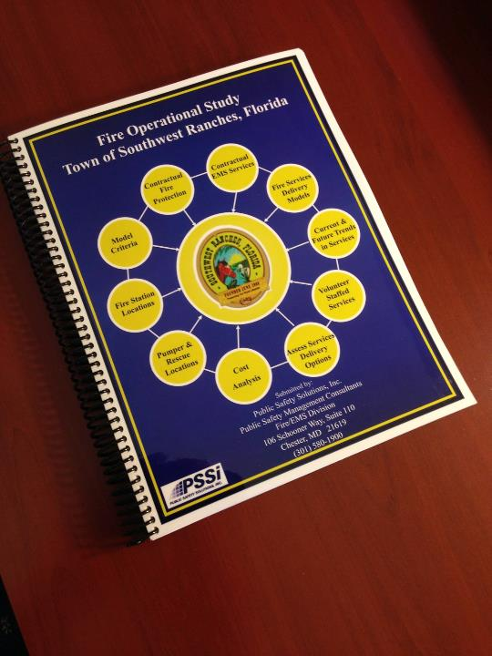
WRITTEN
STUDY
REPORT

Slide 20
Key Point - Report
“Snapshot in Time”
Study Team Professional Opinion/s
Considering Standards/Practices
Town Should Take Input
Consider Options
And Implement w/ Assistance

Slide 21
SELECTED
GRAPHIC DEPICTION
OF FINDINGS

Slide 22
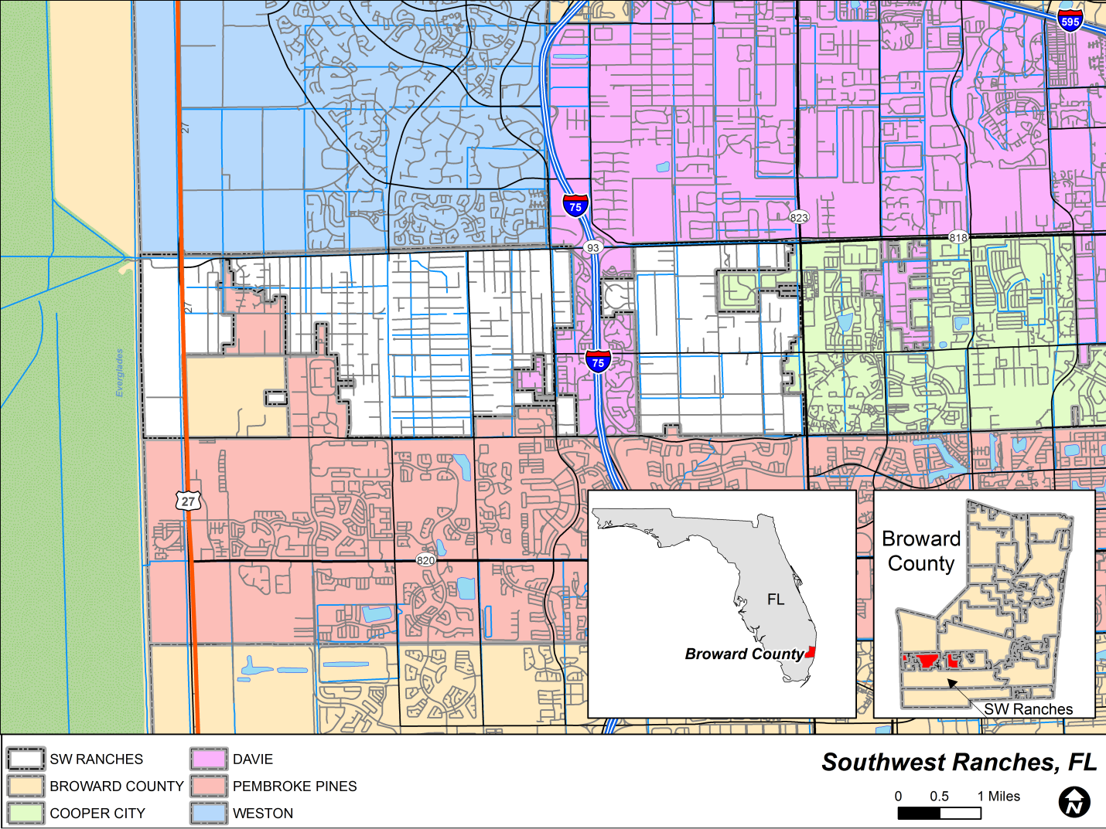
Town of
Southwest
Ranches
Study
Base Map

Slide 23
RISK ANALYSIS

Slide 24
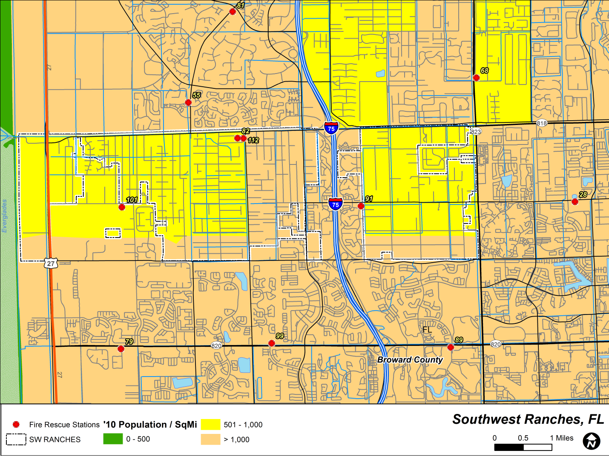
Population (7,345) Density

Slide 25
Population
By Age
Group
Notes:
30

Slide 26
Housing by Occupancy

Slide 27
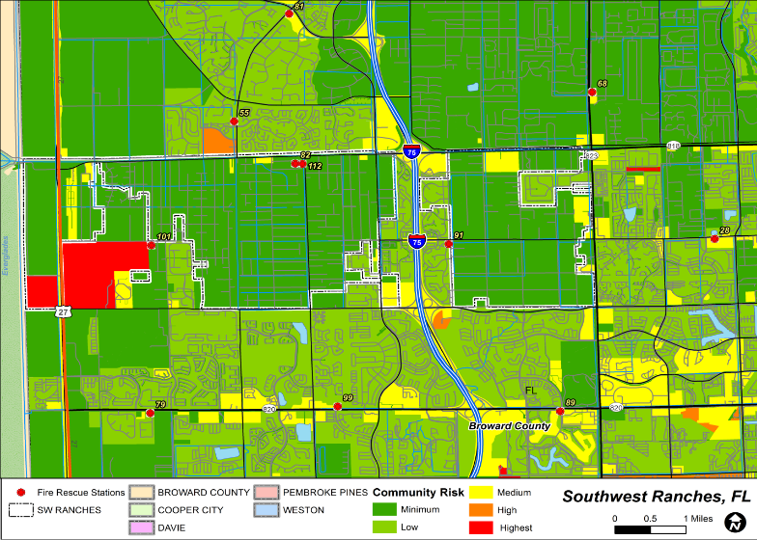
LAND-USE RISK
Notes:
32

Slide 28
CALLS & WORKLOAD
Notes:
33

Slide 29
Notes:
34

Slide 30
Notes:
35

Slide 31
Notes:
36

Slide 32
Notes:
37

Slide 33
RESPONSE TIMES

Slide 34
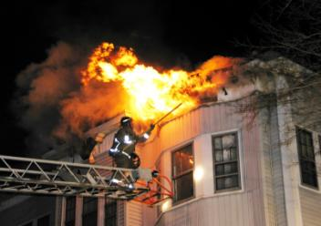
FIRES – RESPONSE TIMES
FIRES
FLASHOVER- 6 to 9 minutes
Pre-Flashover
Post-Flashover
Limited to One Room
May Spread Beyond One Room
Requires Smaller Attack Lines
Requires Larger, More Attack Lines
Search & Rescue Is Easier
Compounds Search & Rescue
Initial Assignment Can Handle
Requires Additional Companies
rd

Slide 35
SIGNIFICANCE OF RESPONSE TIMES
Assessing The Location Of
Fire/EMS Stations And Apparatus
FIRES EMS
6 to 9 minutes Flashover 4 to 6 minutes to Brain Death
in Cardiac Arrest
CRITERIA
NFPA 1710: Utilize 5 minutes*
Public Safety Solutions, Inc: Utilizes 5 minutes*
*Note: Includes turnout time.

Slide 36
Notes:
41

Slide 37
SELECTED
RECOMMENDATIONS
Notes:
42

Slide 38
CRITERIA FOR MODELS

Slide 39
Criteria-Related Options
Consider the suggested model criteria in the implementation of the selected fire and EMS services delivery model/s
Notes:
44

Slide 40
FIRE STATIONS

Slide 41
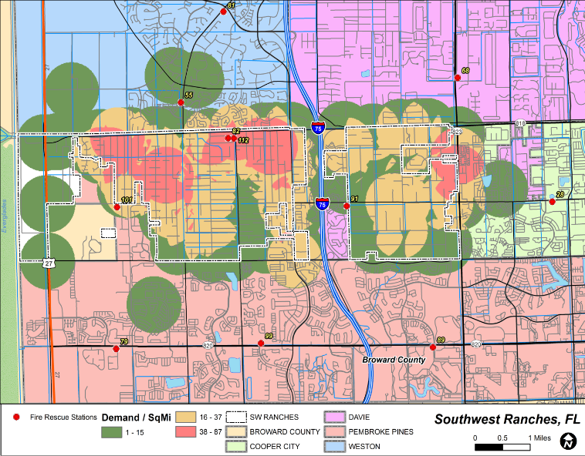
2013 SERVICE DEMAND
Notes:
46

Slide 42
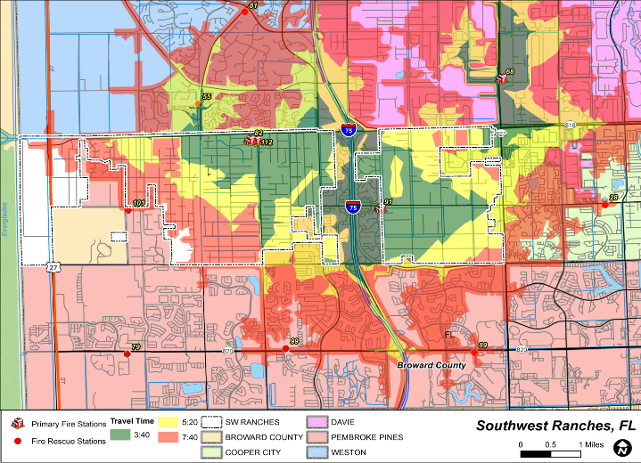
TRAVEL TIME EXTENT
Current
Travel
Time
Model
-
3Mins. 40Secs.
Notes:
47

Slide 43
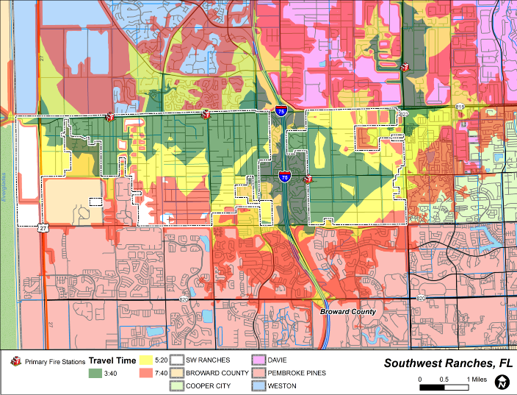
SCENARIO B ― PRIMARY FIRE STATION LOCATIONS WITH CURRENT TRANSPORTATION INFRASTRUCTURE
Travel
Time
Model
-
3Mins. 40Secs.
Notes:
48

Slide 44
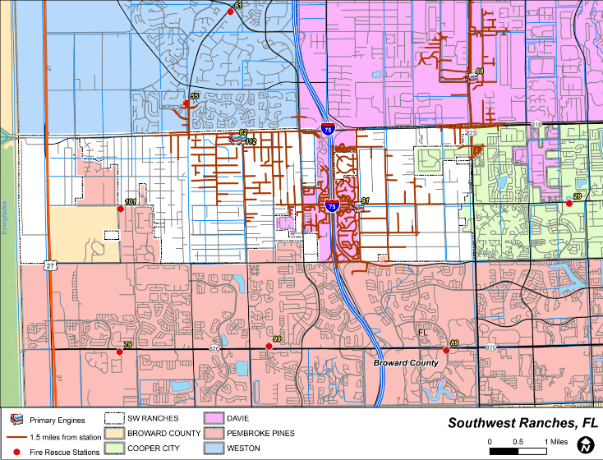
ISO
Engine
1.5 Mile
Distance
Notes:
49

Slide 45
Fire Station Options
Assure that actual address locations are input to the dispatch system;
Consider separating the Station 82/112 resources; and,
Consider an additional station to improve response time.
Notes:
50

Slide 46
APPARATUS

Slide 47
Apparatus Options
Developing and implementing apparatus replacement plan; and,
Consider replacing 1995 Pierce 1250 GPM pumper as front line unit.
Notes:
52

Slide 48
TOWN FIRE
DEPARTMENT

Slide 49
Town Fire Department Option/s
Consider services delivery and related estimated costs of standalone Town Fire Department; and,
If selected, develop and implement detailed budget and implementation plan.
Notes:
54

Slide 50
CONTRACT
SERVICES

Slide 51
Contract Services Option/s
Consider utilizing the current Davie-Town contract as model contract for the future;
Consider five-year contract renewals for the future;
Consider minimum staffing of three staff on pumpers and two on rescue;
Consider response time goals based on NFPA 1710.
Notes:
56

Slide 52
VOLUNTEER
SERVICES
DELIVERY

Slide 53
Volunteer Services Option/s
Modify the mission statement of the SRVFRD;
Consider maintaining teamwork of contractual-VFD in services delivery; and
Consider contract and volunteer resources responding from separate fire stations, if team option to continue.
Notes:
58

Slide 54
VOLUNTEER
RECRUITMENT
&
RETENTION

Slide 55
REGIONALIZATION
AND
COOPERATIVE
SERVICES DELIVERY
Notes:
60

Slide 56
BENEFITS OF COOPERATIVE SERVICES
Increased Efficiency
Improved Effectiveness
Seamless Delivery Of Services
Elimination Of Overlaps In Positions
Elimination Of Duplicate Equipment
Reduced Response Time For Units Dispatched
Increased Opportunity For Staff Specialization;
Upgrading Recruit Training Programs
Opportunity For Increased Promotional Selectivity
Increased Promotional Opportunity For Personnel
Potential Revised Perspective/Outlook Of Personnel
Enhanced Or Expanded Services
Improved Safety Of Customers And Services Providers
Reduced Costs
Improved Incident Command Coverage
Improved Allocation And Utilization Of Staffing
Cost Avoidance
Coordination Of Planning
Standardization Of Services And Programs
Improved And More Effective Training
Potential Improve ISO Rating
Impact On Future State And Federal Grant Funding
Notes:
61

Slide 57
Cooperative Services Options
Encourage full implementation of closest available mutual aid, when feasible.
Notes:
62

Slide 58
Implementation
Timelines
Notes:
63

Slide 59
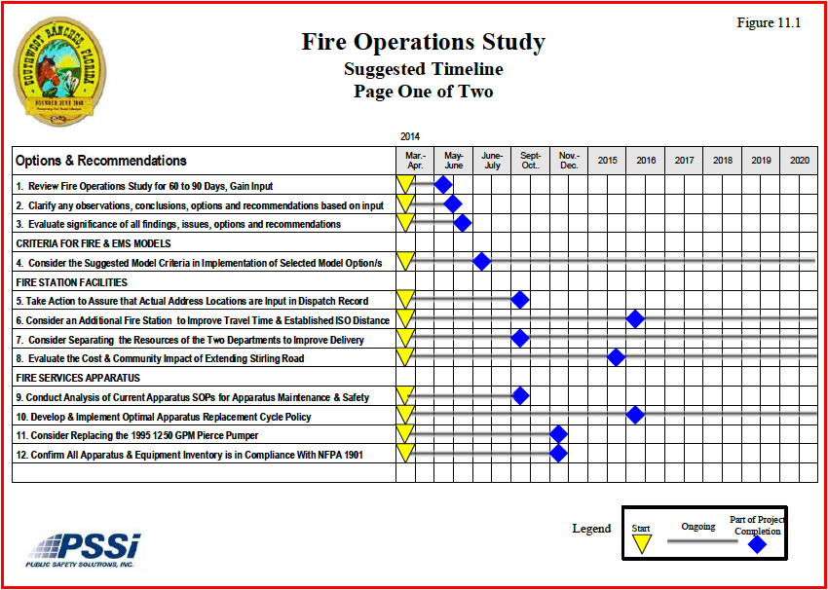
Notes:
64

Slide 60
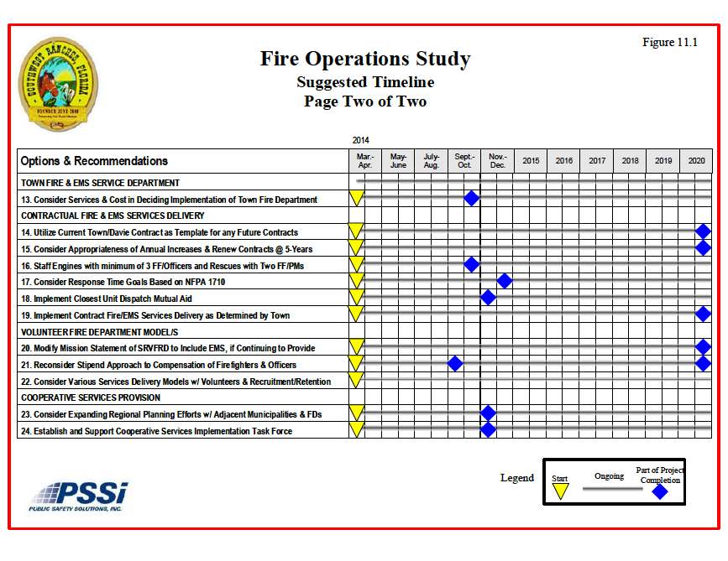
Notes:
65

Slide 61
RETURNS ON INVESTMENT
Enhanced
Service Delivery
Improved Management
Increased Pride in Services
Enhanced Safety &
Training
Reduced Cost
Notes:
66

Slide 62
Recommend Fire Services
Seamless Approach
Recommended

Slide 63
CONSIDER
Models and Recommendations
CUSTOMER
CONSIDER
Relevant Input
MAKE AN INFORMED DECISION

Slide 64
THANK YOU

Slide 65
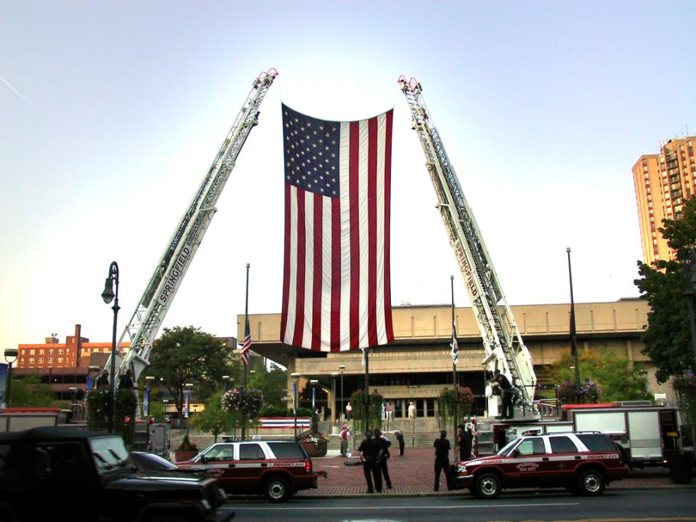
Public Safety Solutions, Inc
Public Safety Management Consultants
301-580-1900

